Slide 1
Lesson 5
Graphing Quadratic Functions in APQ Form:

Slide 2
I) Quadratic Functions written in two different forms:
General Form:
Vertex Form: (APQ form)
Finding the vertex is very easy!!
Axis of Symmetry:
Graphing in APQ form is also easy
All you need to do is find the constants “a”, “p”, and “q”
Y-intercept:
Not as easy finding the vertex

Slide 3
II) Graphing QF:
A Quadratic function in vertex form is much easier to graph
Using constants “a”,”p”, & “q”, we can find the vertex, which way it opens and the congruency value
  Vertex: Axis of Symmetry:
  Domain: Range:
  Y intercept: make x=0, solve for y
  X-intercept: make y=0, solve for x
© Copyright all rights reserved to Homework depot: www.BCMath.ca

Slide 4
III) Horizontal Translations
A parabola will shift left or right depending on the constant “p” that is placed inside the brackets with “x”
Look inside the brackets to find what the value of “p” is
y
8
7
6
5
4
3
2
1
x
-5
-4
-3
-2
-1
0
1
2
3
4
5
-1
© Copyright All Rights Reserved Homework Depot www.BCMath.ca

Slide 5
Ex: Given the following equations a) Find the value of “p” b) Indicate which direction the graph is moved
y
y
8
8
7
7
6
6
5
5
4
4
3
3
2
2
1
1
x
x
-7
-6
-5
-4
-3
-2
-1
0
1
2
3
-7
-6
-5
-4
-3
-2
-1
0
1
2
3
-1
-1
When p=-4, the graph is shifted 4 units left
© Copyright All Rights Reserved Homework Depot www.BCMath.ca

Slide 6
III) Vertical Translations (VT)
A Vertical shift (UP or Down) will occur if a constant is added to the equation outside of the brackets
The value of “x” is squared first and then we subtract the 3
The constant “3” is subtracted outside
of the brackets
y
8
7
6
5
4
3
2
Graph is shifted
3 units Down
1
x
-5
-4
-3
-2
-1
-1
0
1
2
3
4
5
-2
-3
-4
© Copyright All Rights Reserved Homework Depot www.BCMath.ca

Slide 7
Ex: Given the following equations a) Find the value of Q, b) Indicate what translations occurred
y
y
8
8
7
7
6
6
5
5
4
4
3
3
2
2
1
1
x
x
-5
-4
-3
-2
-1
0
1
2
3
4
5
-5
-4
-3
-2
-1
0
1
2
3
4
5
-1
-1
Graph is shifted 2 units UP
© Copyright All Rights Reserved Homework Depot www.BCMath.ca

Slide 8
IV) Summary for Constants “P” and “Q”
The constant “p” affects the graph horizontally
When p=0, the graph is centered on the Y-axis
y
y
y
2 units
Right
2 units
Left
x
x
0
x
0
0
The constant “q” affects the graph vertically
y
y
2 units
up
2 units
Down
0
x
0
x
Interactive
Applet
© Copyright all rights reserved to Homework depot: www.BCMath.ca

Slide 9
Ex: For each of following equations, find the constants “a”, “p”, “q”, vertex, and A.O.S.
© Copyright all rights reserved to Homework depot: www.BCMath.ca

Slide 10
V) How does the constant “a” work?
7
7
Beginning at the vertex we can graph all the other points without making a TOV
5
5
Each point increases horizontally by 1
but increases vertically by 1 , 3 , 5 , 7 , 9, …
3
3
1
1
© Copyright all rights reserved to Homework depot: www.BCMath.ca

Slide 11
10
10
If “a = 2”, the points
go up faster.
Each point increases horizontally by 1
but increases vertically by 2 , 6 , 10 , 14 , 18, …
6
6
Simply multiply the
values by “2”
2
2
© Copyright all rights reserved to Homework depot: www.BCMath.ca

Slide 12
VI) Constant “a” (Congruency Factor)
The constant “a” determines the (congruency) width of the parabola and which way it opens
  If “a” is positive (Opens up)
  If ‘a” is negative (Opens down)
  If “a” is big (Skinny)
  If “a” is small (Wide)
Congruency Factor:
  The constant “a” can be used to determine how fast the points on the parabola go up by
© Copyright all rights reserved to Homework depot: www.BCMath.ca

Slide 13
Practice: Graph the following Parabolas and Indicate the Vertex, AOS, Domain & Range
10
0.5
1.5
2.5
6
3.5
2
© Copyright all rights reserved to Homework depot: www.BCMath.ca

Slide 14
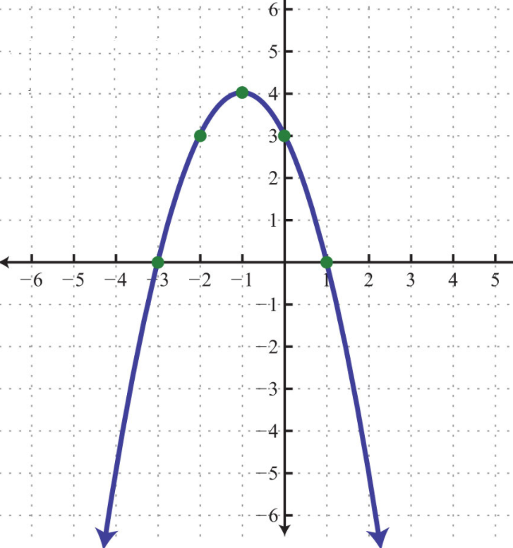
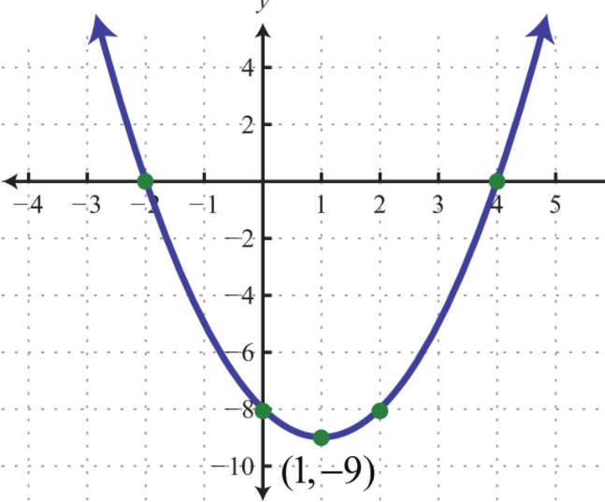
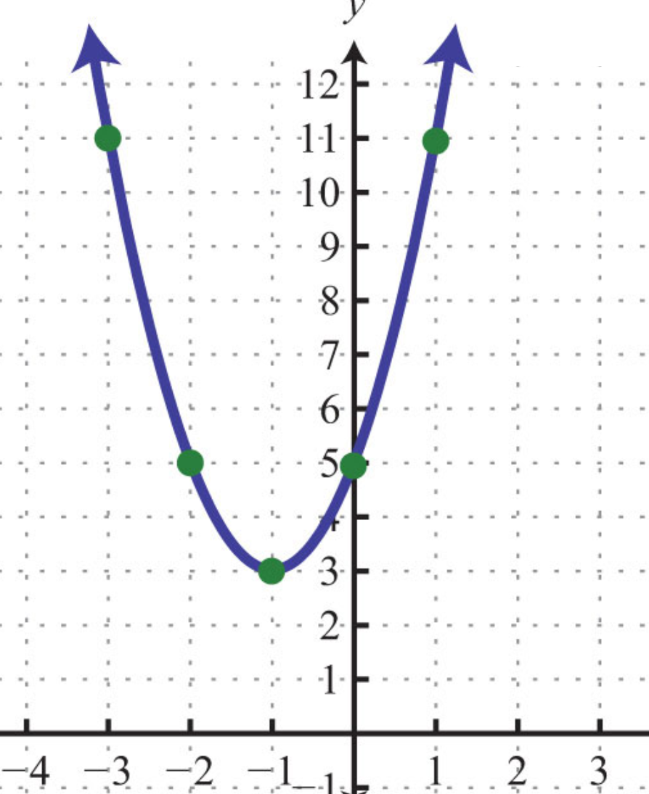
Ex: Find the equation of the following parabolas:

Slide 15
Finding the x-intercepts in APQ form:
Finding the X-intercepts in APQ form requires a little algebra
At the X-intercepts, the y-coordinates are zero, so make y=0 and then solve for ‘x”
Make y=0 and then isolate “x”
Divide both sides by 3
To get rid of the square, square root both sides. DO NOT FOIL!!
You have plus or minus b/c there are two x-intercepts

Slide 16
Practice: Graph each equation then find the following
i) Coordinates of the vertex ii) Eqn of the A.O.S.
iii) X and Y intercepts iv) Domain and Range:

